Slide 1
Debugging Techniques
HoangND1

Slide 2
Objectives
Basic Debugging Technique
Breakpoints
Watches
Stepping
Stopping the Debugger
Conditions and Hit Counts
Break on Exception
Step Into
Trace and Assert

Slide 3
Basic Debugging Technique
The debugger is a tool to help correct runtime and semantic errors
note that no debugging tools are useful in solving compiler errors.
Compiler errors are those that show at the bottom of the screen when compiling

Slide 4
Basic Debugging Technique
If the program isn't working correctly, one of two things could be going wrong:
Data is corrupt somewhere
The code isn’t correct
Example
int a = 0;
int b = 1;
printf("%d", (b/a));

Slide 5
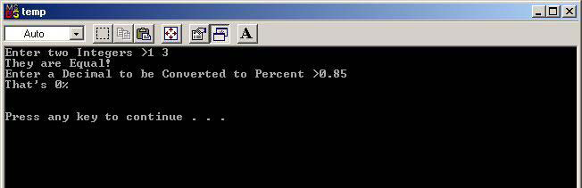
A Buggy Program
Trying to debug a program that's working perfectly is rather pointless

Slide 6
The Buggy Code
#include <stdio.h>
int toPercent (float decimal);
int main()
{
int a, b;
float c;
int cAsPercent;
printf("Enter A >");
scanf("%d", &a);
printf("Enter B >");
scanf("%d", &b);
if (a = b) printf("They are Equal!\n");
else if (a > b) printf("The first one is bigger!\n");
else printf("The second one is bigger!\n");
printf("Enter a Decimal to be Converted to Percent >");
scanf("%f", &c);
cAsPercent = toPercent(c);
printf("That's %d %\n", cAsPercent);
printf("\n\n");
getchar();
return 0;
}

Slide 7
The Buggy Code
/* ToPercent():
Converts a given float (eg 0.9) to a percentage (90).
*/
int toPercent (float decimal) {
int result;
result = int(decimal) * 100;
return result;
}

Slide 8
Debug Mode or Not?
Ctrl+F5 to run your program
The F5 key alone will also run in debug mode.
Build for Debug
Build for Release

Slide 9
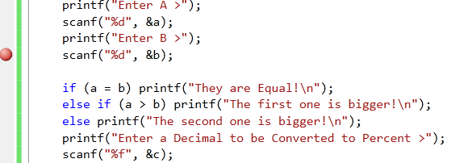
Breakpoints
Breakpoints are the lifeblood of debugging.
Right-click and select "Insert/Remove Breakpoint" or press the F9 key

Slide 10
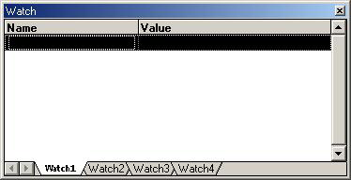
Watches
The "Watch" window lets you watch the contents of any variables you select as your program executes.
Open it from the View menu (Debug Windows >
Watch), or by clicking the "Watch" icon in the toolbar, or by pressing Alt+3

Slide 11
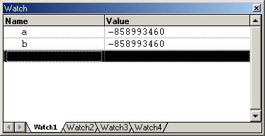
Watches
Enter to add variables to your Watch list:

Slide 12
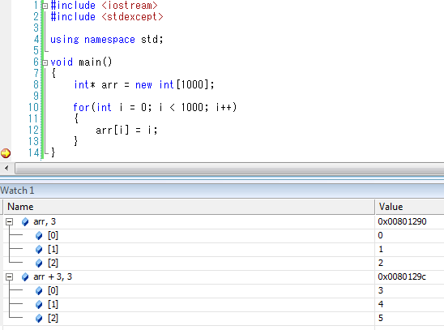
Watches
Watch a range of values inside array:
Syntax: array + <offset>, <range>

Slide 13
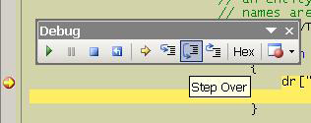
Stepping
Step Over F10
Step Into F11 (Some code inside a function may or may not need to be examined)
Step Out Shift + F11

Slide 14
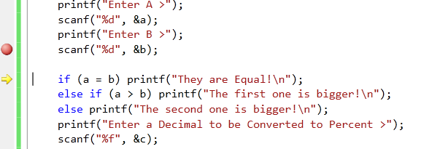
Stepping
When you are tired of stepping through the code, F5 resumes execution.

Slide 15
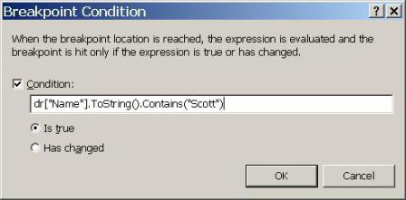
Stopping the Debugger
When you've found a problem to correct, it may be tempting to press Ctrl+C in your program window to end the program
Select "Stop Debugging" from the Debug menu or
on the toolbar or press Shift+F5.

Slide 16
Conditions and Hit Counts
Breakpoint can use conditions and hit counts
Conditions and hit counts are useful if you don’t want the debugger to halt execution every time the program reaches the breakpoint
Only when a condition is true, or a condition has changed, or execution has reached the breakpoint a specified number of times.
Notes:
Conditions and hit counts are useful when setting breakpoints inside of a loop. For example, if
your code iterates through a collection of Customer objects ith a for each loop, and you want to
break on the 10th iteration of the loop, you can specify a hit count of 10. If something bad only
happens when the Customer object’s Name property is equal to “Scott”, you can right click the
breakpoint red glyph, select Condition from the context menu, and enter the expression
customer.Name == “Scott” into the breakpoint condition textbox. Intellisense is available in this
textbox to ensure you are using the correct syntax.

Slide 17
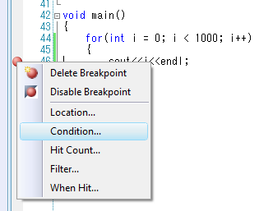
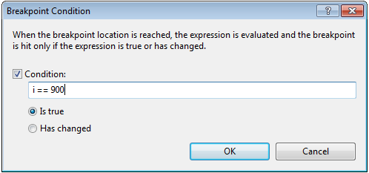
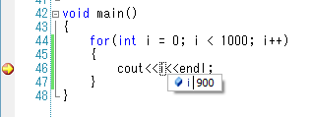
Conditions and Hit Counts
Condition: Is true

Slide 18
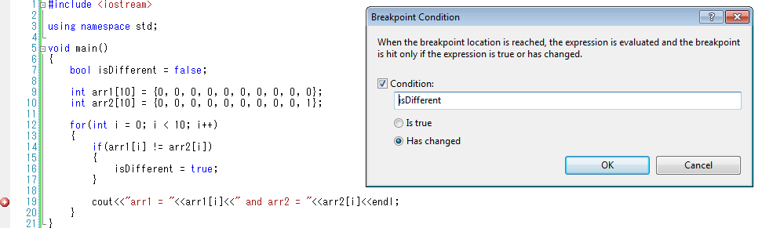
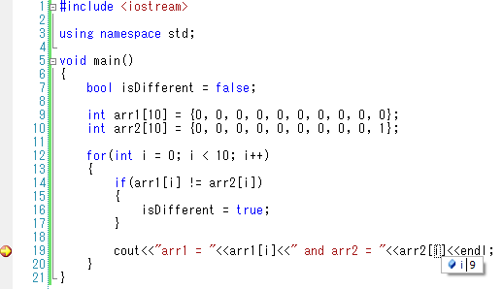
Conditions and Hit Counts
Condition: Has changed

Slide 19
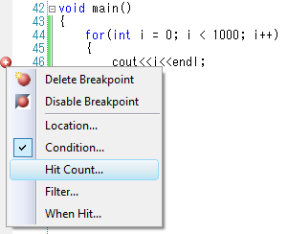
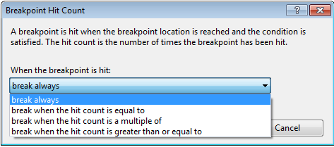
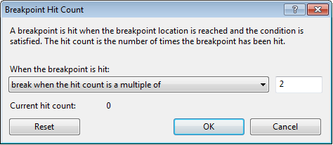
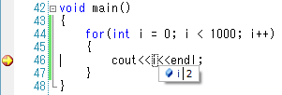
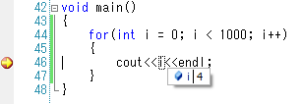
Conditions and Hit Counts
Hit Count: is a multiple of
Notes:
The Hit Count is used along with Condition (use same condition as previous slide: i – Has changed)
Take an example of Hit Count: break when the hit count is a multiple of 2
So, when we press F5, instead of press F5 4 times (if we choose break always) we just press F5 2 times (the number of multiple of 2: 2, 4, 6, 8…)
In this example that is 2, 4

Slide 20
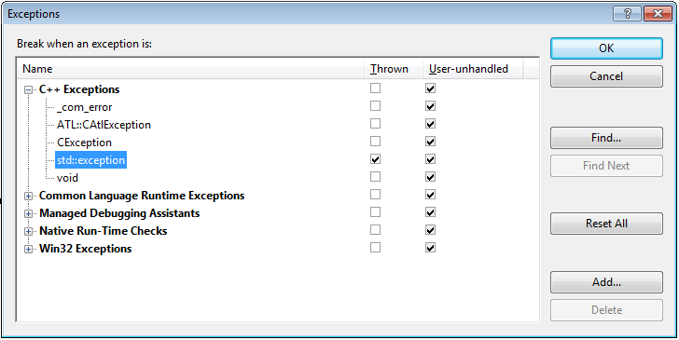
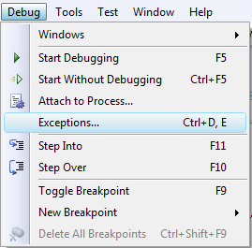
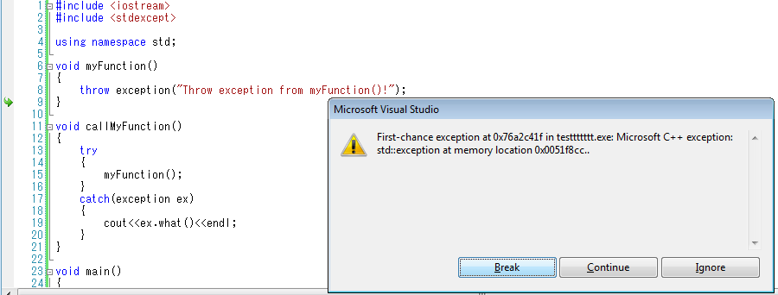
Break on Exception

Slide 21
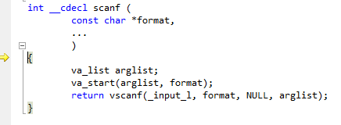
Stepping Into Assembly
Be careful when you "Step Into" lines involving
printf, scanf, or other system functions!

Slide 22
Debug commands
Command | Meaning
Ctrl+F5 | Run program
F5 | Run in debug mode
F9 | Create breakpoint
F10 | Step over
F11 | Step into
Shift + F11 | Step out
Shift + F5 | Stop debugging
Ctrl + Tab | Change window

Slide 23
Trace and Assert
Trace: Allows the programmer to put a log message onto the main output window
Assert: To check program assumptions

Slide 24
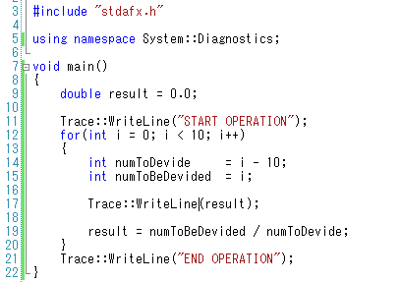
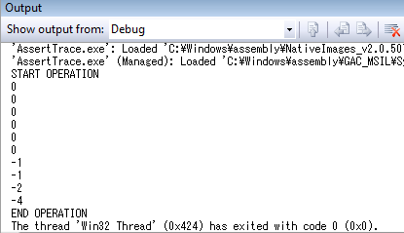
Trace and Assert
Press F5
Keep tracing code processing by output value during debugging

Slide 25
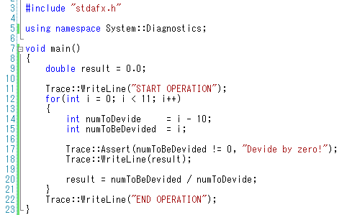
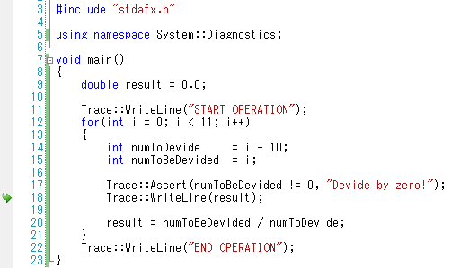
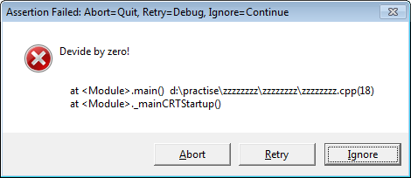
Trace and Assert
This code contain potential bug, if another developer change 10 to other values (such as 11)
We use Assert to validate that the value is valid or not
Press Retry allow us to debug after Assert

Slide 26
Trace and Assert
The behavior for Trace will not change between a debug and a release build
This mean that we must #ifdef any Trace-related code to prevent debug behavior in a release build

Slide 27
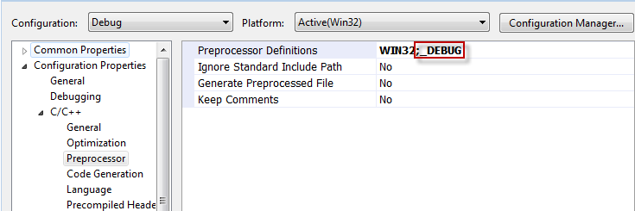
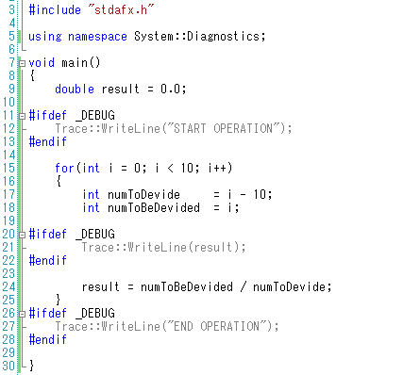
Trace and Assert
_DEBUG is automatically defined for Debug mode
We can use #ifdef _DEBUG to prevent debug behavior in release mode

Slide 28
Questions and Answers

